Slide 2
Back to Collections
Lists:
ArrayList
LinkedList
Sets
No duplicates
No order (TreeSets happen to have an order)
Maps (more to come)
Mapping a key to a value
E.g., our soccer players: map each player to a position
Each player is unique, each position doesn’t have to be
The player’s name should bring up their position

Slide 3
Sets: Definition
A Set is a Collection that cannot contain duplicate elements.
It models the mathematical set abstraction.
The Set interface contains only methods inherited from Collection
But not the list interface…
They’re not structured like lists!
adds the restriction that duplicate elements are prohibited.
Set elements are not ordered in the way that elements in a list are ordered…
They may actually have an order, but we don’t think of a set as being ordered
E.g., events occurring over time

Slide 4
Sets
Uses the Collection interface
So has to implement the method signatures in the Collection interface
E.g., add, remove, contains,
In this case, the add method must not only add the object to the set, it must check to see if the object is already in the set and only add it if it is not already in the set)
Note that we don’t have a get method
does Collection interface have a get signature?
Get doesn’t make sense with sets:
Set.get(index)
There’s no order to a set
TreeSet/HashSet
Both sets implemented by java using the Collection interface

Slide 5
Hash Set
Used more frequently
Faster than TreeSet for contains, add, remove
Generally faster than lists too! (but not the same as lists)
No ordering
Idea: we take an object that we want to place into the set, then use a “hashing function” on the object to get a unique index (hopefully). The object is then placed at that unique index in an array.
E.g., a ridiculously simple hashing function (that no one would ever use) is:
take the numeric equivalent of all the characters in an object’s fields,
add them together,
and then take that number modulus the length of the array into which we are placing the object.

Slide 6
HashSets
Idea: Use a “hashing function” on an object to get a unique index and place the object at that unique index in an array.
Issues to think about :
What if more than one object generates the same index? What do we want to do then?
How big should we make the original array? Is this wasteful?
How do we make sure the hash function doesn’t generate index values outside of the range of the array?
Goal: to be able to locate objects quickly
The hash function should generate the same index for all objects that are equal

Slide 7
Methods:
add(o) appends the new object o to the set
addAll(c) adds everything from collection c to the HashSet (at the end)
clear() removes all elements from the set
contains(o) returns true if the set contains the object o
containsAll( c) returns true if the set contains all the elements in the collection set
equals( c) checks if the collection c and the hashset have the same set of objects
isEmpty() returns true if the set contains no elements
remove(object) removes the object from the set and returns true if successful, false otherwise
removeAll(c) remove from this set all the elements in the collection set
retainAll(c) keeps in the set only objects in the collection
size() returns the number of elements in the set
toArray()
toString()

Slide 8
HashSet<String> hs = new HashSet();
// add elements to the hash set
hs.add("B");
hs.add("A");
hs.clear();
hs.add("D");
hs.add(“U");
hs.add("C");
hs.add("F");
hs.remove("F");
hs.remove(1);
hs.add("D");
hs.add(1, “E");
hs.add ("K");
System.out.println(hs);
// What does this give you?

Slide 9
TreeSet
Tree
Faster than HashSet for subset
Ordered!
Theoretically should be pretty quick for adding, removing, and contains (log n time), even while maintaining sorted order

Slide 10
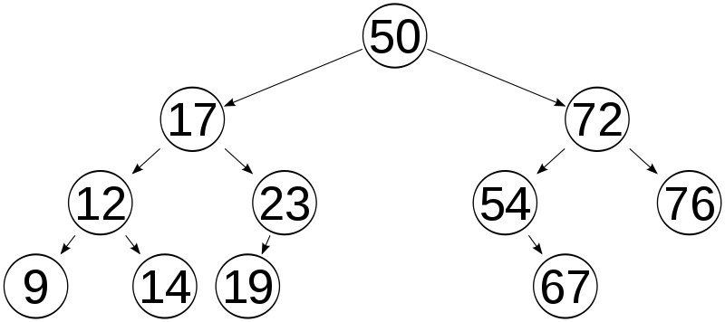
Idea:
Add 51? Add 15?

Slide 11
Methods:
add(o) appends the new object o to the set
addAll(c) adds everything from collection c to the HashSet (at the end)
ceiling(0) Returns the least element in this set greater than or equal to the given element, or null if there is no such element.
clear() removes all elements from the set
contains(o) returns true if the set contains the object o
containsAll( c) returns true if the set contains all the elements in the collection set
descendingSet() – returns a reverse order view of the set
equals(c) checks if the collection c and the hashset have the same set of objects
first() returns the smallest element in the set
floor( o) returns the greatest element in the set less than o
higher( o) retuns the first element after o in the set
isEmpty() returns true if the set contains no elements
last() – returns the last object in the set
lower( o) – returns the greatest object in the set that is less than the object o
remove(object) removes the object from the set and returns true if successful, false otherwise
removeAll( c) remove from this set all the elements in the collection set
retainAll( c) keeps in the set only objects in the collection
size() returns the number of elements in the set
subset(o1, o2) – returns a view of the set of objects that range from the first object (inclusive) to the last object (exclusive)
tailSet(o) – returns a view of the set whose elements are greater than or equal to the object
toArray()
toString()

Slide 12
TreeSet
TreeSet<Integer> tree = new TreeSet();
tree.add(12);
tree.add(63);
tree.add(34);
tree.add(45);
tree.add(16);
tree.add(22);
tree.add(54);
Iterator<Integer> it = tree.iterator();
while (it.hasNext()) {
System.out.print(it.next() + " ");
}
System.out.println(tree.subSet(22,54));
if (tree.isEmpty()) {
System.out.print("Tree Set is empty.");
} else {
System.out.println("Tree Set size: " + tree.size());
}
System.out.println("First data: " + tree.first());
System.out.println("Last data: " + tree.last());
if (tree.remove(45)) {
System.out.println("Data is removed from tree set");
} else {
System.out.println("Data doesn't exist!");
}
tree.clear();
if (tree.isEmpty()) {
System.out.print("Tree Set is empty.");
} else {
System.out.println("Tree Set size: " + tree.size());
}
12 16 22 34 45 54 63
[22, 34, 45]
Tree Set size: 7
First data: 12
Last data: 63
Data is removed from tree set
Tree Set is empty.

Slide 13
What is this the Node definition for?
public class Node<AnyType> {
public AnyType data;
public Node<AnyType> next;
public Node(AnyType data, Node<AnyType> next)
{
this.data = data;
this.next = next;
}
public Node(AnyType data)
{
this.data = data;
this.next = null;
}
}
Can you modify it for a Node in a tree?
public class Node<AnyType> {
public AnyType data;
public Node<AnyType> leftChild;
public Node<AnyType> rightChild;
public Node(AnyType key) {
this.key = key;
this.leftChild = null;
this.rightChild = null;
}
public Node(AnyType data, Node<AnyType> left, Node<AnyType> right)
{
this.key = key;
this.leftChild = left;
this.rightChild = right;
}

Slide 14
public class Tree {
Node root;
public void addNode(Integer key) {
Node<Integer> newNode = new Node(key); // Create a new Node and initialize
if (root == null) { // If there is no root this becomes root
root = newNode;
}
else { // Set root as the Node we will start with as we traverse the tree
Node<Integer> focusNode = root;
Node<Integer> parent; // Future parent for our new Node
while (true) {
parent = focusNode; // root is the top parent so we start there
if (key < focusNode.key) { // Check if the new node should go on the left side of the parent nod
focusNode = focusNode.leftChild; // Switch focus to the left child
if (focusNode == null) { // If the left child has no children
parent.leftChild = newNode; // then place the new node on the left of it
return; // All Done
}
}
else if (key > focusNode.key){ // If we get here put the node on the right
focusNode = focusNode.rightChild;
if (focusNode == null) { // If the right child has no children
parent.rightChild = newNode; // then place the new node on the right of it
return; // All Done
}
}
else { //already in tree
return;
}
}
}
}
...

Slide 15
public void PrintTree(Node focusNode) {
// Recursion is used to go to one node and then go to its child nodes and so forth
if (focusNode != null) {
PrintTree(focusNode.leftChild); // Traverse the left node
System.out.print(focusNode + " "); // Visit the currently focused on node
PrintTree(focusNode.rightChild); // Traverse the right node
}
}

Slide 16
What did I just do?
public ArrayList<String> fn(ArrayList<String> al) {
HashSet<String> set = new HashSet();
set.addAll(al);
al.clear();
al.addAll(set);
return(al);
}

